Slide 1
DIGITAL PAYMENTS

Slide 2
bhim – Bharath interface for money UPI - Unified Payment Interface
VARIOUS MODES OF PAYMENT :
UPI, Wallets, POS, and SMS banking (USSD)

Slide 3

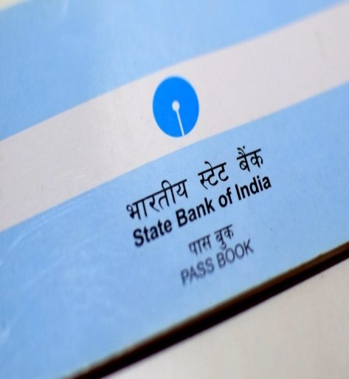

Requirements for registration on UPI
Requirements :
Smartphone with internet facility.
Bank Account details (only for registration).
An APP provided by the bank or third party APPS.

Slide 4




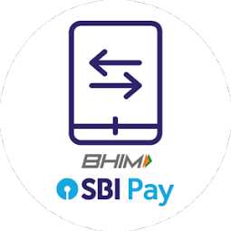



Third Party apps :
Apps provided by bank :

Slide 5
UPI Registration Process
Choose your unique ID (Aadhar, Mobile No.) as Virtual Payment Address (VPA)
Download any bank’s
app or 3rd party app
Select your bank
Registration Completed
Set M-PIN for validating transactions
Give account details for first time

Slide 6
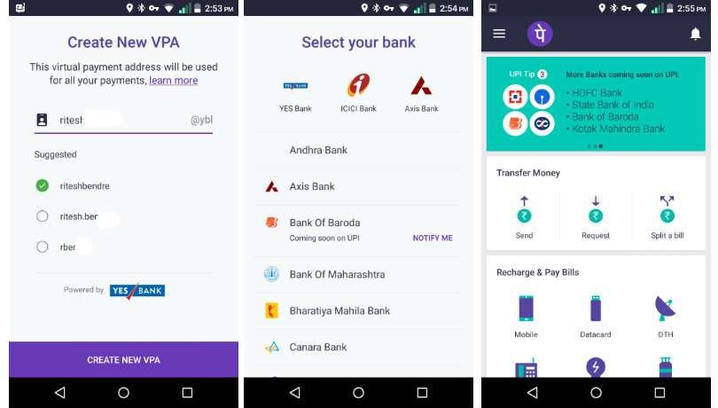
Sample Screenshots (PhonePe app)

Slide 7
Sending Money on UPI
Enter payee’s Virtual Payment Address
Choose “Send Money”
Enter amount
Confirm the
details
Write remarks
for transaction
(optional)
Hit “Send”

Slide 8
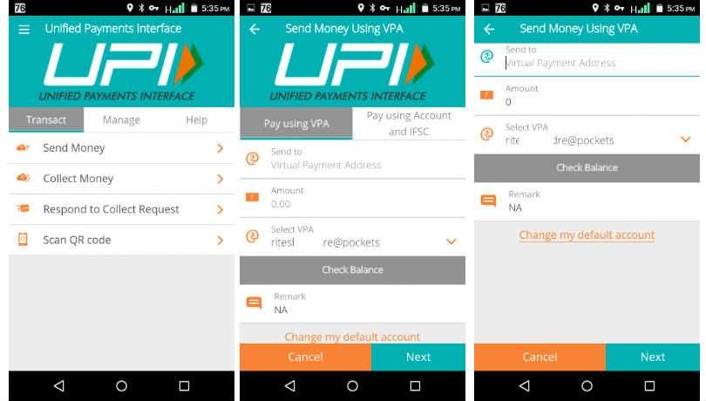
Sending Money

Slide 9
Collecting Money on upi (raise a demand)
Enter payer’s Virtual Payment Address
Choose “Collect Money”
Enter amount
Enter when do you want to collect
Write remarks
for transaction
Hit “Confirm”

Slide 10
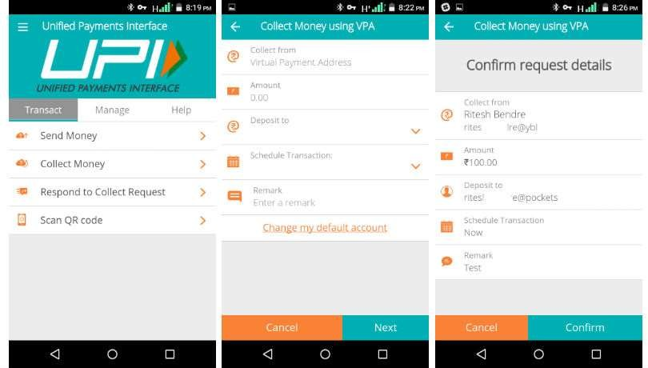
Collecting Money

Slide 11
THANK YOU

